Slide 1

Road Fatalities:
An Exploratory Analysis of Road Fatalities in The US During The Year 2020.
Eimaan (Ash) Ejaz, Savina Boateng, Zeeshan Karim, and Lishani Srikaran
Notes:
Lishani
Our group did an exploratory analysis of road fatality in the US during the year 2020.

Slide 2
RESEARCH QUESTIONS
Many road fatalities occur every year, and finding insights could help to take action to reduce these fatalities?
Can the age of a driver impact the likelihood of them being involved road accident?
What weather conditions and routes are road fatalities most likely to occur on?
Are road fatalities more likely to occur at a certain hour of the day?
What impact do speed limits have on the total number of road fatalities?
Notes:
Savina: Many road fatalities occur every year, wouldn’t it be great to help find insights to take action to reduce these fatalities?
Can the age of a driver of a driver impact the likelihood of them getting into a road accident?
Can the weather condition and route impact the likeliness of an individual being a victim of road fatalities?
Do road fatalities occur more often at a certain hour of the day?
Do more road fatalities occur at a certain speed limit?

Slide 3
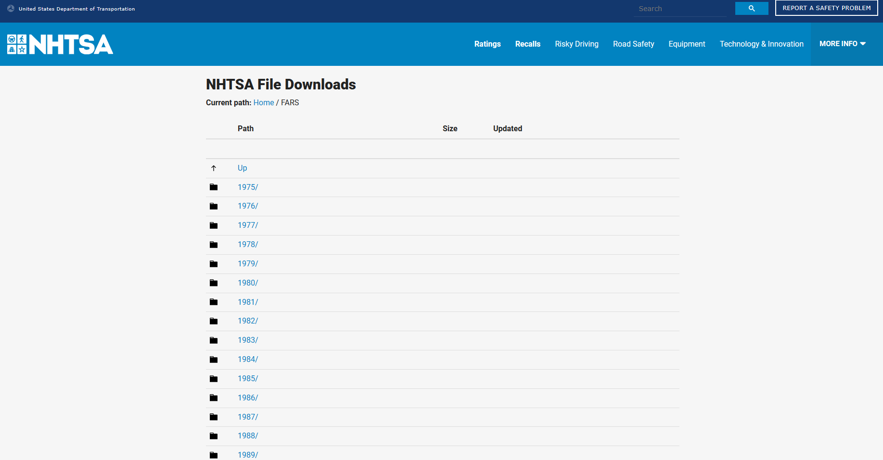
DATA SOURCE
The data was sourced from The National Highway Traffic Safety Administration (NHTSA).
The NHTSA is an agency of the U.S. federal government. Their road fatality records are available to source both though an API and also through CSV files for each year.
API: https://crashviewer.nhtsa.dot.gov/CrashAPI
CSV Archives: https://www.nhtsa.gov/file-downloadsp=nhtsa/downloads/FARS/2021/National/
Notes:
Ash: We chose to source our data from the National Highway Traffic Safety Administration (NHTSA)
This is an agency of the U.S. federal government so we trusted that the data would be both accurate and reliable.
The data was extensive enough for our analysis as there were numerous variables recorded including but not limited to weather conditions, drug involvement and fatality counts.
The data was available through both an API and also through CSV files, however we were unable to make API requests without providing additional filters which would have reduced the size of the dataset. For this reason we decided to utilise the CSV file instead.

Slide 4
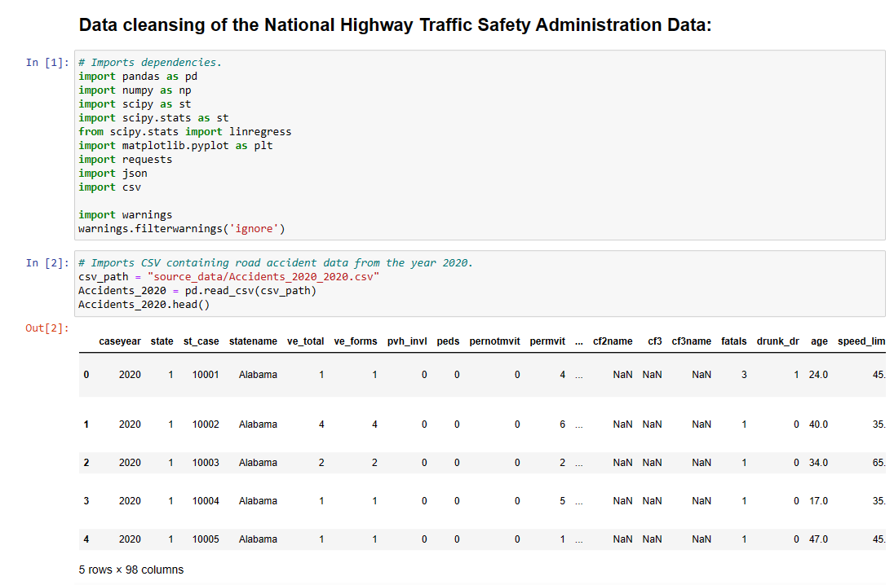
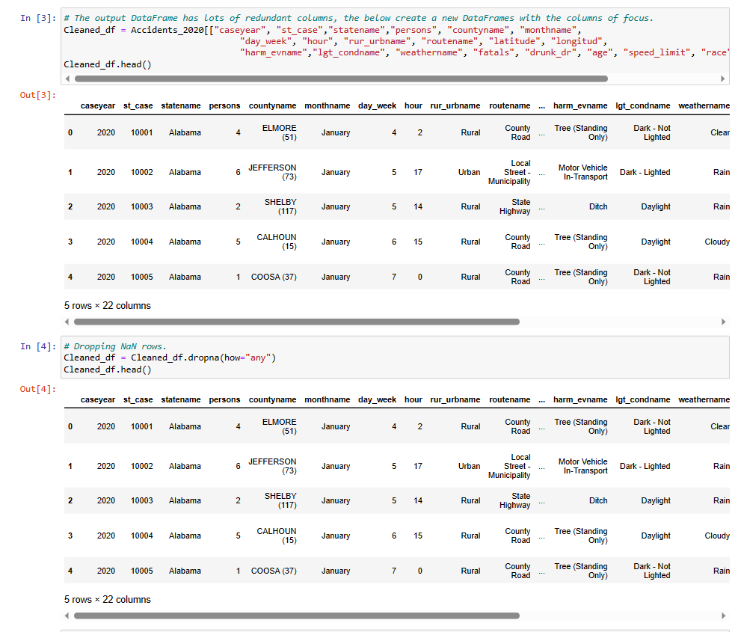
DATA EXPLORATION / CLEAN UP PROCESS
Notes:
Lishani
To clean up we import the CSV file and read it as a DataFrame, removed redundant columns and any rows which contained a null value.

Slide 5
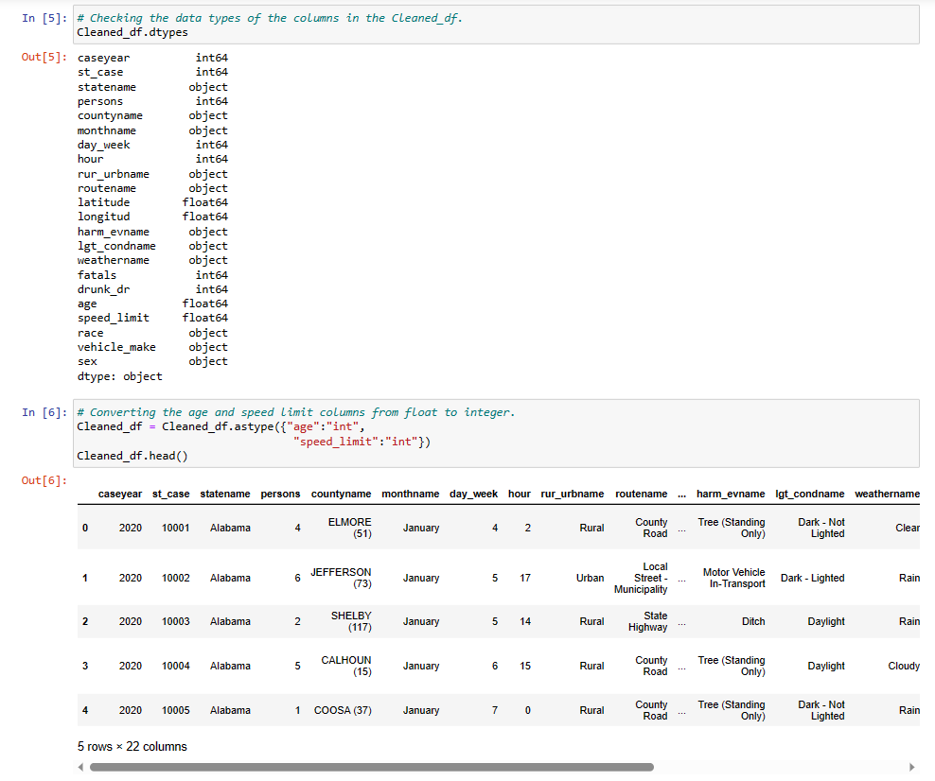
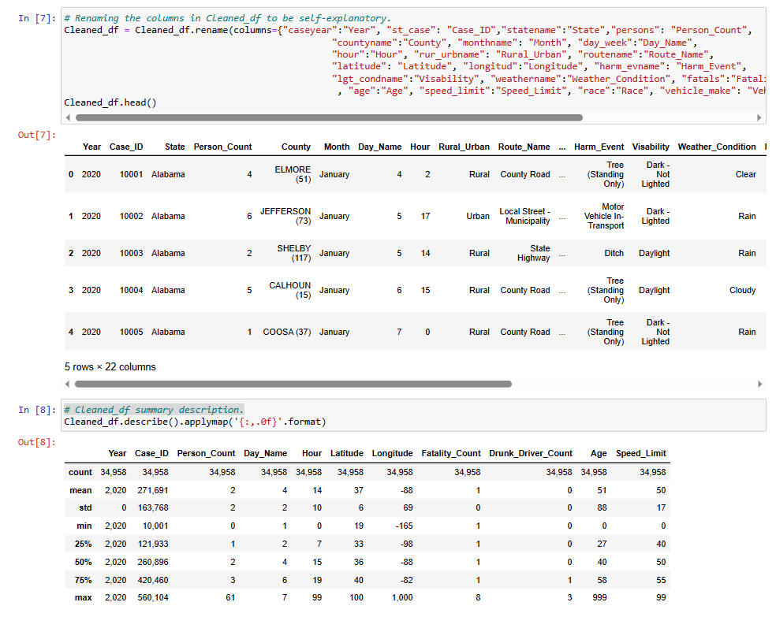
DATA EXPLORATION / CLEAN UP PROCESS
Notes:
Changed the data types of age and speed limit values from a float to a integer; ready for analysis and renamed columns to be self explanatory.
To also give us a quick oversight of the data we gathered the summary statistics of each column using summary statistics.

Slide 6
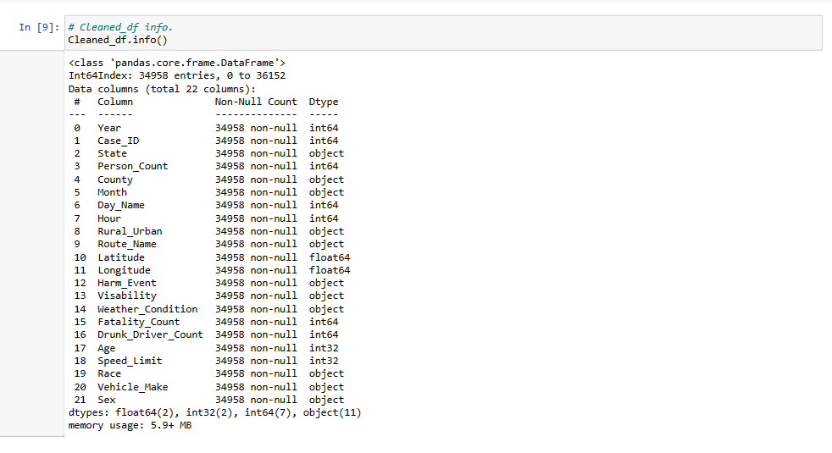
Notes:
Ash - Upon displaying the information for our cleaned dataframe, we were able to see there were no longer any null values and the relevant datatypes had been corrected. At this point the data was therefore ready for analysis.

Slide 7
ANALYSIS
Notes:
Moving on to our Analysis

Slide 8
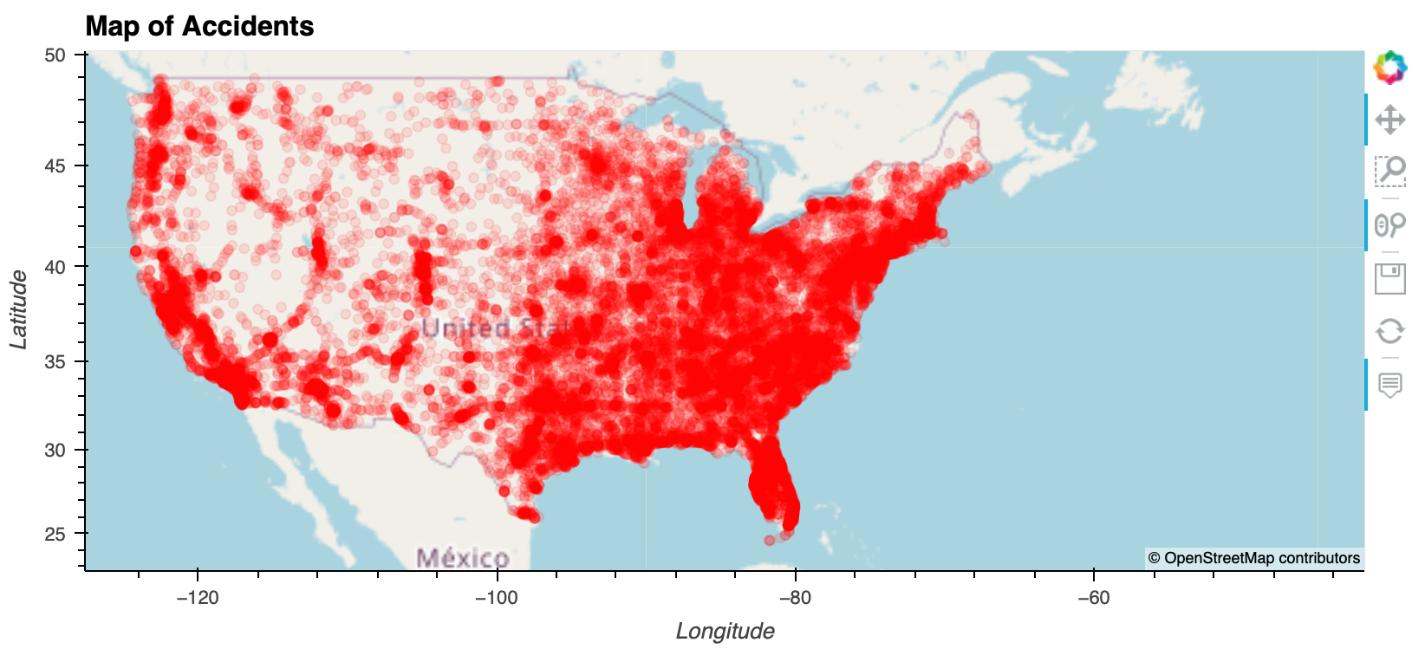
Notes:
The first thing we did was plot each accident on a map to see the spread on a national level. We can clearly see a concentration of accidents on the Eastern half of the country as well as along the West Coast.

Slide 9
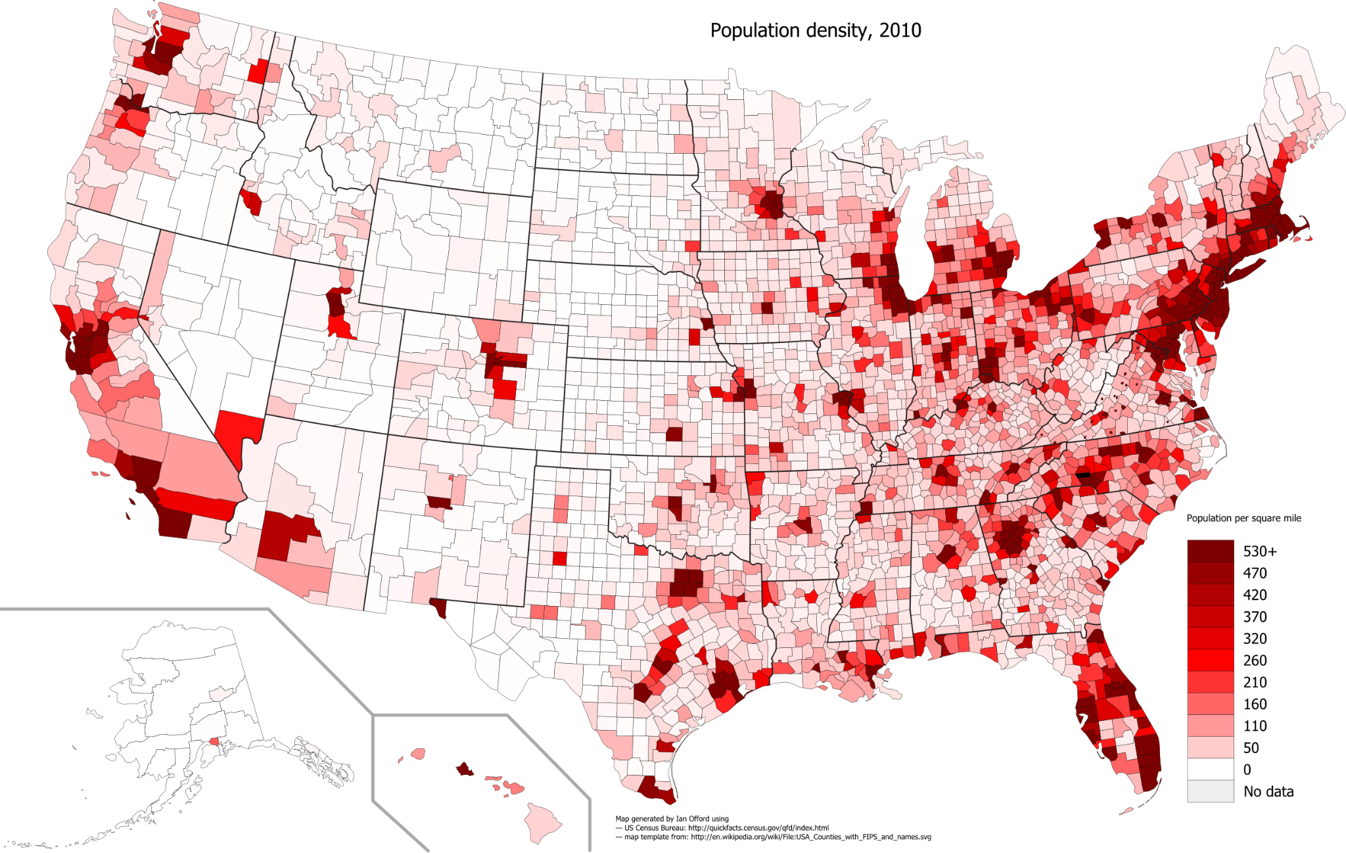
Our Accident Map vs Population Density (USA)
Source: ECPM via US Census Bureau
Notes:
This pattern matched up nicely with the population density of the USA.

Slide 10
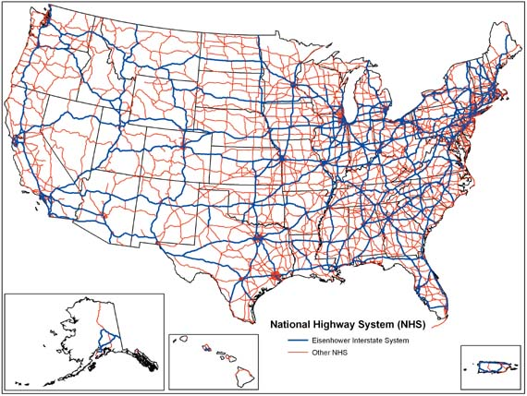
Our Accident Map vs US Highway Network Map
Source: Wikipedia via US Federal Highway Administration
Notes:
It also matched up nicely with the National Highway system. This made sense as naturally, where the population is more concentrated, and where highways are more concentrated, there are more likely to be more road accidents in these regions.

Slide 11

Q1: Is there a relationship between the age of the driver and the number of accidents?
Notes:
The first question we wanted to explore for our analysis was [question]. This was because there is a common assertion that younger drivers cause more accidents and we wanted to see if we could prove this with data.

Slide 12
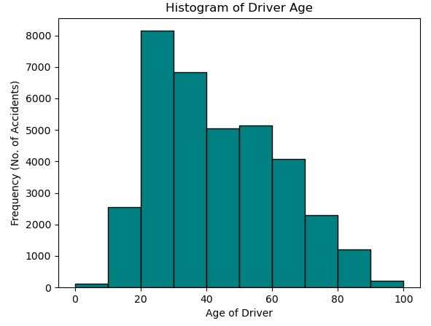
Distribution & Measures of Central Tendency
The distribution of the age of drivers is right-skewed
The median and mode would be more representative of average driver age than the mean
This means that younger drivers may be more likely to get into accidents
Mean Age: 43
Median Age: 40
Mode Age: 28
Notes:
The first thing we did was look at the distribution of the ages of the drivers in our accident database. From the histogram we can see a clear right-skew of data meaning the lower mode and median age would be more likely to represent the average driver who gets into a road accident. This initial exploration did indicate that most accidents are caused by younger drivers.

Slide 13
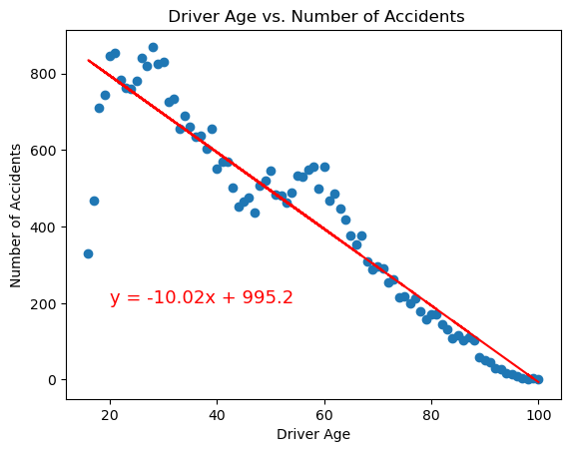
Linear Regression
Strong negative correlation between driver age and number of accidents
May be linked to the demographic split of all drivers
Pearson correlation coefficient: r = -0.94
Notes:
We then performed a linear regression of driver age against number of accidents. We can clearly see a strong negative correlation with a Pearson r value of -0.94. This again shows that the most accidents are caused by younger drivers.
However we must note that this may be related to the number of drivers of each age on the road. For example, there are likely to be fewer drivers aged 16 and 17 as well as over age of 80 which could be part of the reason why there are fewer accidents for these age groups.

Slide 14
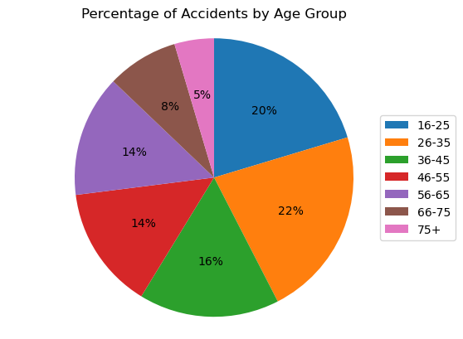
Conclusion (1)
Young people seem to be more likely to get into road accidents than older people.
The age group forming the highest % of accidents is 26-35.
The most common age to get into a road accident is 28.
Further research is needed to see if these figures are proportional to the full driving population.
Notes:
To conclude the findings for this question, we were able to show that young people do seem to get into more road accidents than older drivers, with drivers under 35 causing almost half of all accidents. However, as mentioned, further research would be needed to determine if these figures are proportional to the demographic split of the full driving population.

Slide 15
Q2: What weather conditions and routes is a road fatality most likely to occur on?

Slide 16
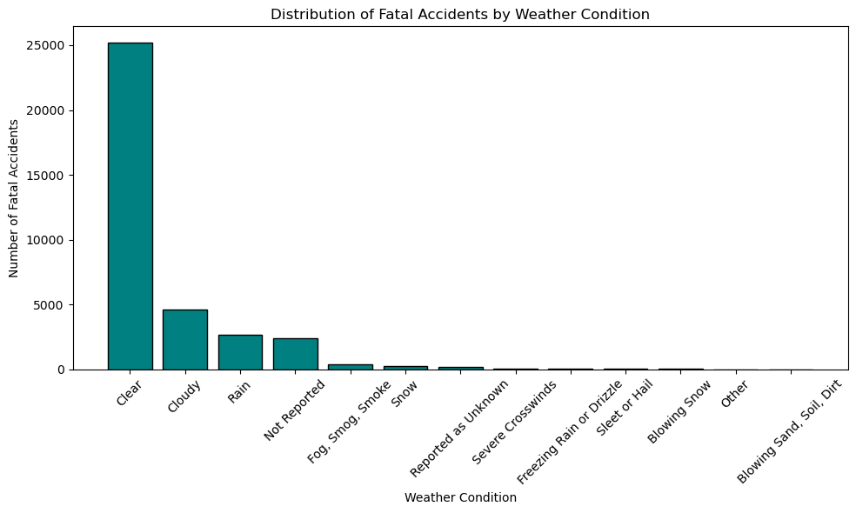
Weather Condition vs Fatality
The bar chart shows the Distribution of Fatal Accidents by Weather Conditions.
Most accidents occured with clear weather conditions (almost 25000), compared to the other weather conditions outlined.

Slide 17
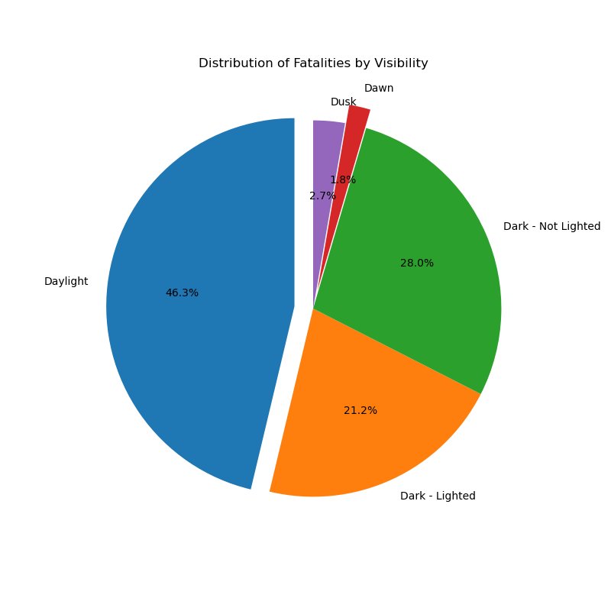
Visibility Vs Fatality
This pie chart shows the Distribution of Fatalities vs Visibility.
It is clearly shown that most fatalities (46.3%) occurred during the daylight.

Slide 18
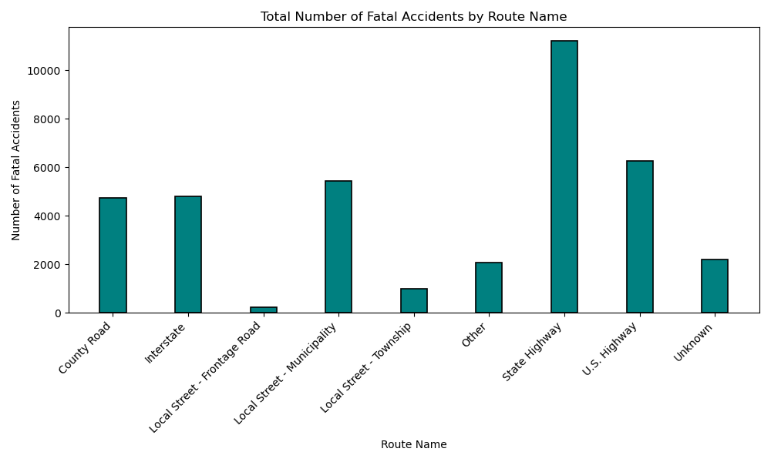
Route Name vs Fatality
This bar chart shows the the Total Number of Fatal Accidents by Route Name.
Most fatalities (over 10000) occurred on the State Highway.

Slide 19
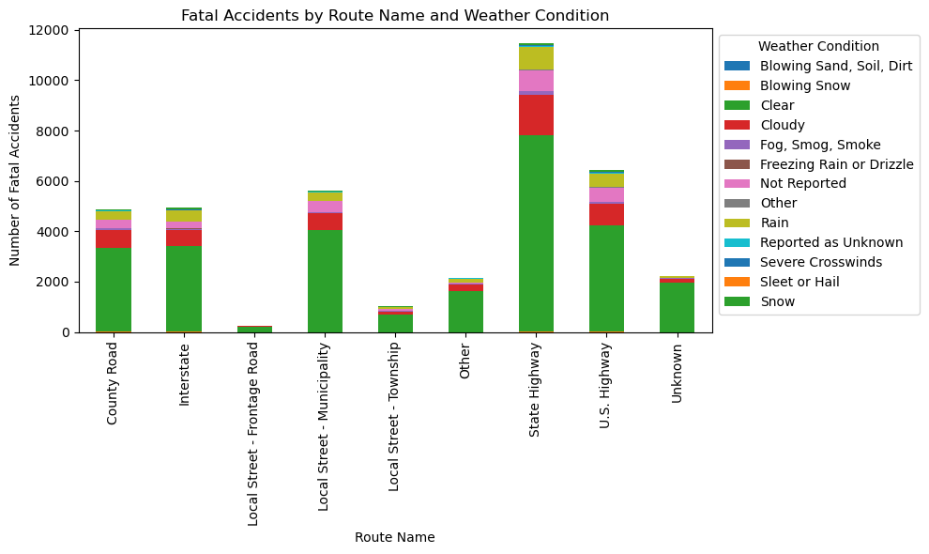
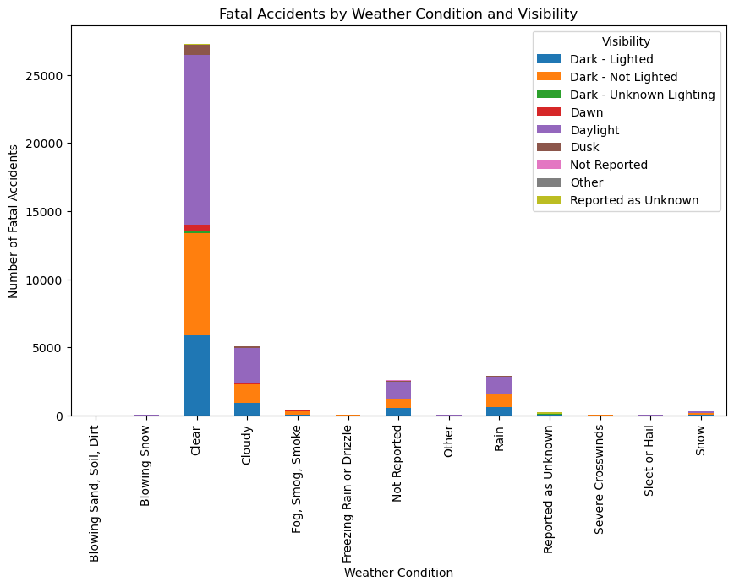
Both stacked bar charts show that most fatalities occurred in clear weather conditions, during the daylight.
This confirms the findings of the charts discussed previously.

Slide 20
Conclusion (2)
The analysis above indicates that clear weather conditions pose a higher risk for fatal accidents regardless of the specific route.
Due to people using transport to commute to their daily obligations, it is also seen that most accidents occur during daylight rather than darker times.

Slide 21
Q3: Are road fatalities more likely to occur at a certain hour of the day?

Slide 22
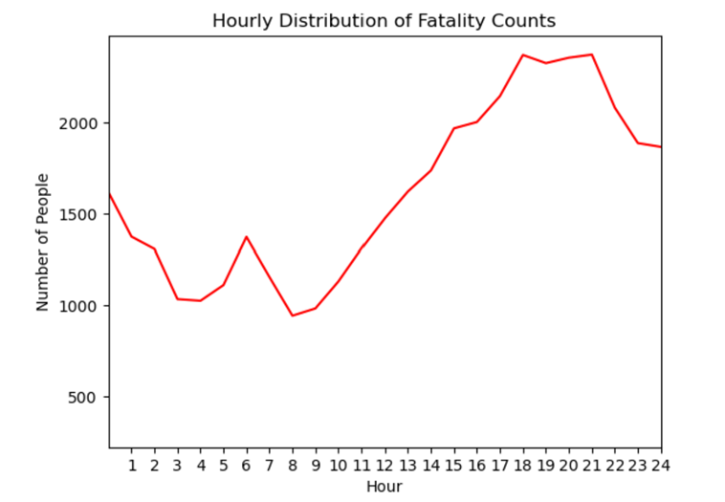
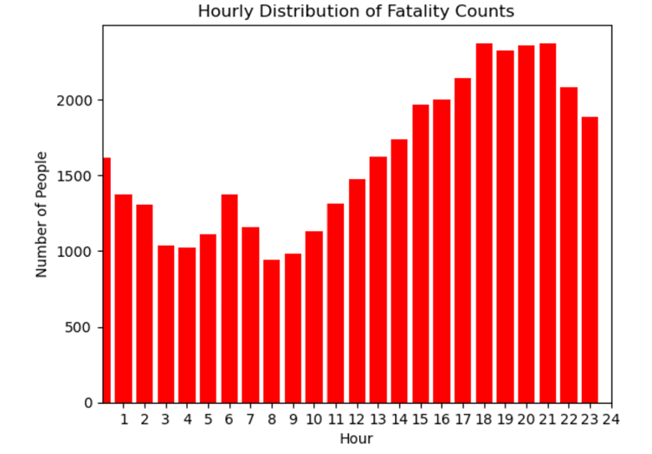
Fatality count at each hour of the day
Steady increase in the number of fatalities between hour 10 and 18.
Most fatalities occur between the hours 18 to 22.

Slide 23
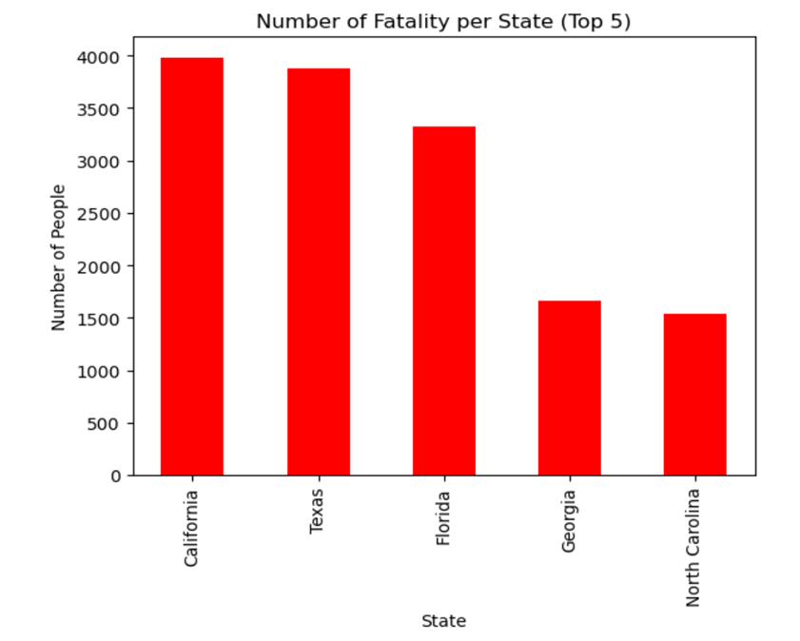

Number of fatalities per state
California has the highest the highest number of fatalities. Followed by Texas.

Slide 24
Conclusion (3)
Between 10 to 18 hours, the steady increase is likely due to more activity of road users.
Most fatalities occur between the hours 18 to 22. This is most likely due to the activity of road user. This could be as a result of visibility as it gets darker later in the day.
California’s number of fatalities is likely a result of population density.

Slide 25
Q4: What impact does speed limit have on the total number of road fatalities?
Notes:
Our Null hypothesis for this question is the increasing speed limit of a road does not affect the likelihood of an individual experiencing a fatal road accident.

Slide 26
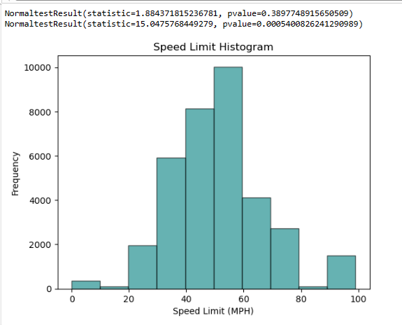
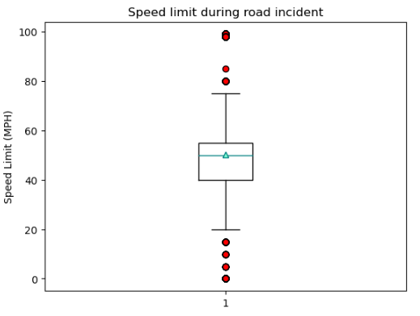
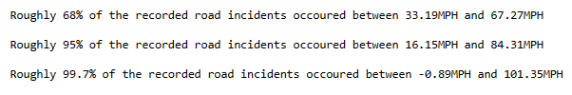
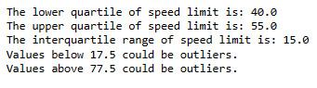
Speed Limit Vs Fatality
Notes:
First the speed limit data’s distribution was observed using a histogram. As you can see, it quite nicely follows a bell shaped curve structure.
The box plot which shows virtually the same mean and median, it shows that on average a road accident is most likely to occur at 50MPH, this is due to the data being normally distributed.

Slide 27
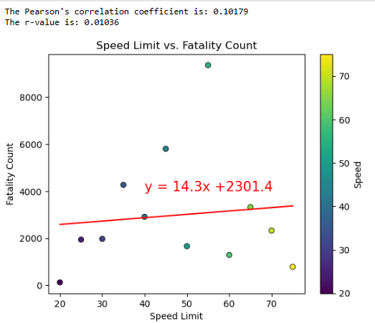
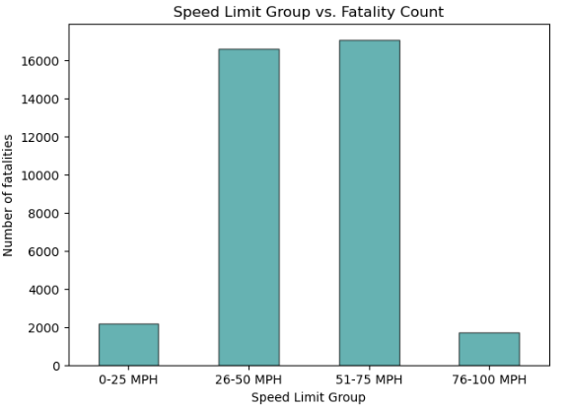
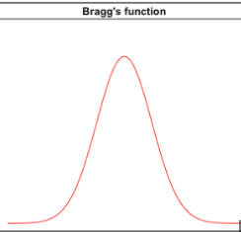
An increase of one MPH in the speed limit corresponds to a increase of 14 additional fatalities which is very insignificant when observing on a nationwide scale.
A Bragg’s function regression would help help regress values better.
Notes:
Next a scatter chart was plotted showing speed limit versus fatality counts, the correlation coefficient calculated was 0.1 indicates a very weak linear correlation. An increase of one MPH in the speed limit corresponds to a increase of 14 additional fatalities which is very insignificant when observing on a nationwide scale.
Although the scatter plot did not indicate a linear relationship, when the speed limits are grouped, you can see that most incidents occurred between the two middle groups therefore there is still some sort of correlation it just isn’t linear. Perhaps a Bragg’s function regression would help help regress values better.
The reason why a linear regression isn’t followed is because there are less roads with higher speed limits so the cumulative fatality counts recorded are lower.

Slide 28
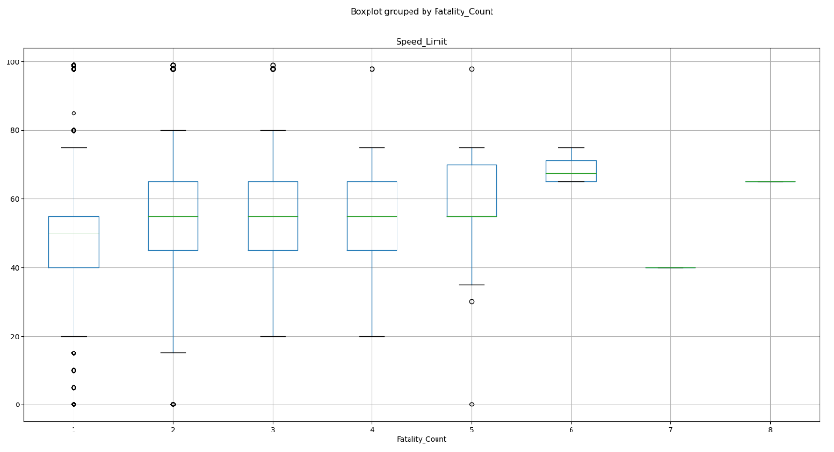

Conclusion (4)
A road fatality is most likely to occur on a road of 50MPH.
Speed limit does have a impact on the likelihood of a fatality, the relationship is not linear however.
Notes:
Finally a Anova t-test was performed confirmed that the median of speed limits does increase up until a certain point. However, the computed pvalue is below the significance level of 0.05 and therefore, the null hypothesis could be rejected.

Slide 29
WHAT ARE THE IMPACTS OF OUR FINDINGS?
Improve road safety measures (e.g. filtering systems during busy times)
Public awareness and education/targeted interventions for those at more risk such as younger/first time drivers including refreshing knowledge
Stricter driving examination for those applying for licenses
Implementation of a nation-wide minimum driving age (18)
Improve policy development (avoid speed limits of 50 MPH?)
Notes:
Zeeshan

Slide 30
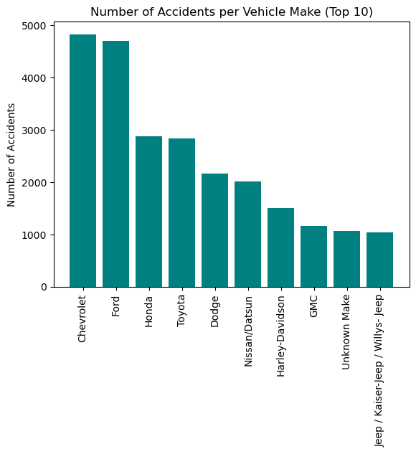
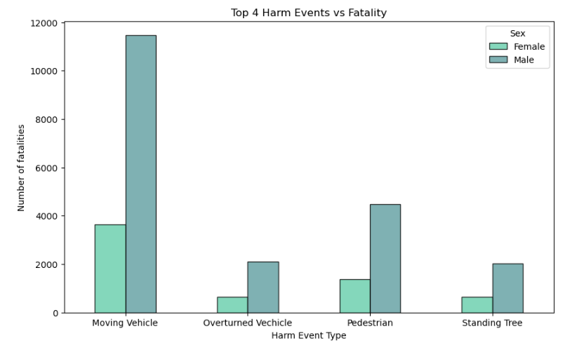
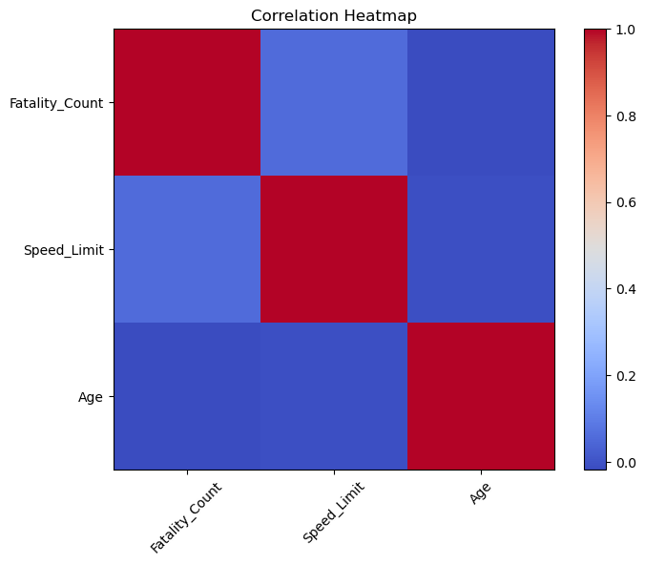
ANY QUESTIONS?
Additional explorations:

